Slide 1
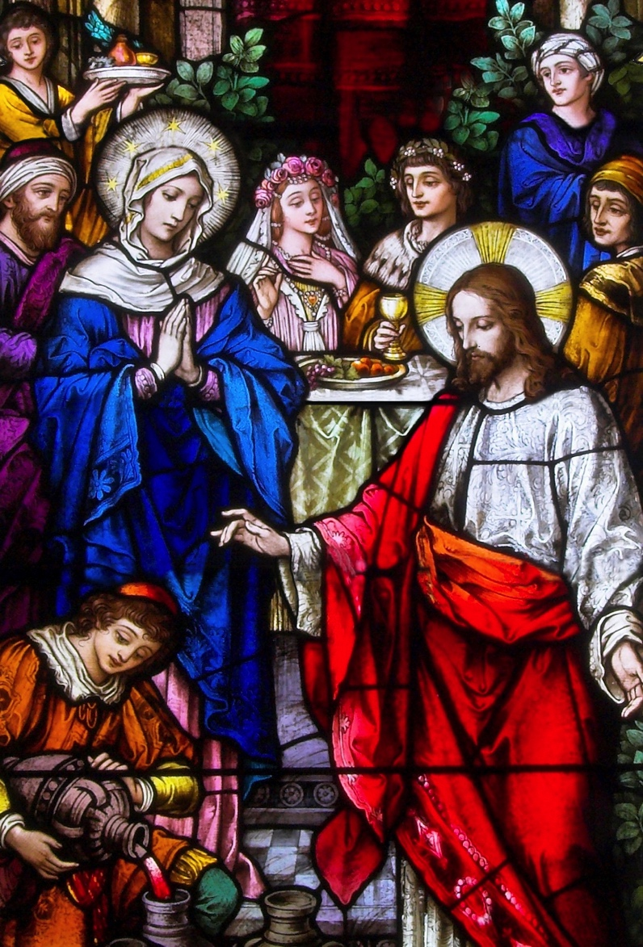
The United Nations and Human Trafficking: How the Holy See Engages the Discussion and Work
Free, Full, Faithful and Fruitful Love
Fr. Roger J. Landry
Fifth Annual
Families Encountering Christ Camp
On the Theme “Building Love” Diocese of Lubbock
Christ the King Cathedral June 30-July 1, 2018
Fr. Roger J. Landry
Permanent Observer Mission of the
Holy See to the United Nations
Louisiana Summit on Modern Slavery and Human Trafficking
May 9, 2018

Slide 2
Encountering Christ and Building Love
Second Vatican Council:
GS 22:“Christ fully reveals man to himself and makes his supreme calling clear.”
GS 24: “Man cannot discover himself except in the sincere gift of self.”
Four Characteristics of Love mentioned by Soon-to-be St. Pope Paul VI 50 years ago in Humanae Vitae
Context of Humanae Vitae
Critique of Cardinal Karol Wojtyla/St. John Paul II

Slide 3
Paul VI’s Four Characteristics of Love
Humanae Vitae 9 — “Husband and wife, through the mutual gift of themselves, which is specific and exclusive to them alone, develop that union of two persons in which they perfect one another, cooperating with God in the generation and rearing of new lives.”
With that introduction, it says that the characteristic features and demands of married love are:
Fully human and free
Full or total
Faithful and exclusive until death
Fruitful

Slide 4
The Big Picture of Love
God is love, an eternal loving Communion of Persons, and formed the human person in his image and likeness for love.
God’s love is free, full, faithful and fruitful
We are called to receive, reciprocate and share that love of God.
“In this is love: not that we have loved God, but that he loved us and sent his Son as expiation for our sins” (1 Jn 4:10)
“You shall love the Lord, your God, with all your heart, with all your soul, and with all your mind.” (Mt 22:37)
“Love one another as I have loved you” (Jn 15:12)
Love is not just a gift but a task

Slide 5
The Big Picture of Love
Love is patient, kind, not jealous, not pompous, not inflated, not rude, not self-interested, not quick-tempered, doesn’t brood over injury, doesn’t rejoice over wrongdoing but rejoice in the truth, bears all things, believes all things, hopes all things, endures all things. (1 Cor 13:1-8)
The person who loves is sincere, hates evil, holds to the good, is affectionate, anticipates others in showing honor, constantly zealous, fervent in spirit, serves the Lord, rejoices with hope, endures affliction, perseveres in prayer, contributes to the needs of others, exercises hospitality, blesses those who persecute him, rejoices with those who rejoice, weeps with those who weep, isn’t haughty, associates with the lowly, conquers evil with good, is concerned with what is noble, lives at peace with all. (Rom 12:9-21)

Slide 6
The Big Picture of Love
Four words for love in Greek
Storge
Philia
Eros
Agape
Stages of love in Love and Responsibility
Attraction
Desire
Goodwill
Sympathy
Friendship
Betrothed Love

Slide 7
The Big Picture of Love
Sacramental participation in Christ’s spousal love
Eph 5:21-23
Reverence one another out of reverence for Christ
Husbands love as Christ loves the Church; Wives love as the Church loves Christ.
The great mystery. Human marriage flows from Christ’s, not the other way around
The Covenantal Aspect of Love
The Statements of Intention pronounced by couples before their marital vows

Slide 8
The United Nations and Human Trafficking: How the Holy See Engages the Discussion and Work
Loving with Freedom
Fr. Roger J. Landry
Permanent Observer Mission of the
Holy See to the United Nations
Louisiana Summit on Modern Slavery and Human Trafficking
May 9, 2018

Slide 9
Love That Is Fully Human and Free
Bl. Paul VI in Humanae Vitae:
“Love is above all fully human, a compound of sense and spirit. It is not, then, merely a question of natural instinct or emotional drive. It is also, and above all, an act of the free will, whose trust is such that it is meant not only to survive the joys and sorrows of daily life, but also to grow, so that husband and wife become in a way one heart and one soul, and together attain their human fulfillment.”
God’s love is Free
Statement of Intention: “Have you come here freely … intent upon giving yourself to your intended spouse in marriage?”

Slide 10
Love That Is Fully Human and Free
“Positive” Characteristics of Freedom
Freedom cannot be understood as a license to do “absolutely anything:” it means a “gift of self.”
The paradox of love and freedom: Freedom exists for love, commitment and self gift. But we freely limit one form of freedom for the fulfillment of freedom in love.
Mutual choice to give and receive.
The Nuptial meaning of the body, of the person.
The Book of Genesis highlights the conscious and free choice that gives rise to marriage.
Our character is built through the free choices we make.
The link between freedom and the truth.
The link between freedom and the good

Slide 11
Love That Is Fully Human and Free
“Negative” Characteristics of Freedom
Not controlled or manipulated or compelled by another person
No internal or external pressure or constraint.
“Shotgun weddings” and the problem of pregnancy.
Ultimatums.
Parental pressure.
Not dominated by a disordered desire

Slide 12
Love That Is Fully Human and Free
The Necessity of Chastity
Lack of chastity robs us of freedom. Only the chaste person is capable of true love, because only the chaste person is free from the domination of the temptation to use others.
Most are confused about what chastity is:
Difference between chastity and continence/abstinence
Difference between chastity and celibacy
Understanding Chastity and…
Temperance/continence
Love
Purity
Piety
The virtue of chastity is a self-mastery tied to ascetical practices and discipline that bears fruit in serenity and peace.

Slide 13
Love That Is Fully Human and Free
Problems making fully human and free love more challenging:
Enslavement in general, to oneself, to one’s urges.
Confusion about meaning of freedom
Selfishness and individualism.
LF 14. Individualism presupposes a use of freedom in which the subject does what he wants, in which he himself is the one to "establish the truth" of whatever he finds pleasing or useful. He does not tolerate the fact that someone else "wants" or demands something from him in the name of an objective truth. He does not want to "give" to another on the basis of truth; he does not want to become a "sincere gift.” Individualism thus remains egocentric and selfish.
Fear of commitment, entrapment.
Addictions to alcohol, drugs, sex, porn.
Forced marriage, child marriage

Slide 14
The United Nations and Human Trafficking: How the Holy See Engages the Discussion and Work
Loving Fully
Fr. Roger J. Landry
Permanent Observer Mission of the
Holy See to the United Nations
Louisiana Summit on Modern Slavery and Human Trafficking
May 9, 2018

Slide 15
Loving Fully
Blessed Paul VI in Humanae Vitae 9 said that love is full or total:
It’s “a very special form of personal friendship in which husband and wife generously share everything, allowing no unreasonable exceptions and not thinking solely of their own convenience. Whoever really loves his partner loves not only for what he receives, but loves that partner for the partner's own sake, content to be able to enrich the other with the gift of himself.”
God’s love is total, as we see in Jesus
Jesus calls us to that type of full love
Statement of Intention: “Are you … without reservation intent upon giving yourself to your intended spouse in marriage?”

Slide 16
Loving Fully
“Positive” Characteristics of a Love that is Full
Involves the whole of the person in fullness of self-surrender and completeness of personal commitment: one’s body, mind, fertility, finances and unknown future health conditions.
Aims at a “deeply personal unity, a unity that, beyond union in one flesh, leads to forming one heart and soul” (CCC 1643)
“Demands indissolubility and faithfulness in definitive mutual giving” (CCC 1643)
Until death, not “until further notice,” or “for as long as we both shall love.”
Can’t be past action alone, but continuous, each day, self-giving love.
Involves a mutual belonging (AL 319)
Features a priority commitment over other loves, over work.
Modeled on the Eucharist.
Ultimately desires God for the person, the truest happiness, truest good.
Self-mastery is needed to give like this.

Slide 17
Loving Fully
“Negative” Characteristics of a Love that is Full
There is no totality in eros without marriage. Shared attractions, desires or emotions are not enough.
Doesn’t mean losing one’s identity, melding into each other, giving up healthy boundaries or letting oneself be abused.
Must accept the whole of the other, including those parts that annoy or you wish were different.
Love and Responsibility: take away the fullness of self-surrender and completeness of personal commitment, what remains will be a total denial and negation of it.

Slide 18
Loving Fully
Problems confronting the fullness of love
Giving partially because one is divided
Trust issues
A failure to appreciate properly and give and receive with regard to the fullness of the respective masculinity and femininity.
Taking rather than giving. Using rather than loving.
Lack of honesty, hiding or keeping critical information from one’s fiancé(e) that would fit with reservations
Pre-nuptial agreements.
Polygamy

Slide 19
The United Nations and Human Trafficking: How the Holy See Engages the Discussion and Work
Loving Faithfully and Exclusively
Fr. Roger J. Landry
Permanent Observer Mission of the
Holy See to the United Nations
Louisiana Summit on Modern Slavery and Human Trafficking
May 9, 2018

Slide 20
Loving Faithfully and Exclusively
Bl. Paul VI said in Humanae Vitae that love is faithful and exclusive of all other until death
God’s love is faithful and irrevocable, fulfilled in Jesus
Spouses have the ability to share in and represent this love
Statement of Intention: “Will you love and honor your intended spouse for the rest of your life?”

Slide 21
Loving Faithfully and Exclusively
“Positive” characteristics of faithful and exclusive love
One keeps his or her promises, no matter how feelings change.
It involves a covenant, commitment, like God’s.
Positive acts of faithfulness. Little things of renewing the choice for the other, putting the other first.
Faithful in thought, word and action.
Faithful to God at the same time.

Slide 22
Loving Faithfully and Exclusively
“Negative” characteristics of faithful and exclusive love
It can seem difficult, even impossible, to bind oneself for life to another human being. Requires trust, holy daring, and God’s help.
It involves guarding one’s heart, eyes, body, keeping one’s erotic love exclusively for the spouse.
In means fighting and avoiding temptations toward lust, and step-by-step acts of infidelity when one experiences attraction and even desire for someone else, or when one’s attractions and desires for one’s spouse may temporarily wane.
No flirting with others

Slide 23
Loving Faithfully and Exclusively
Problems challenging faithful and exclusive love
Infidelity and untrustworthiness
Pornography
Adultery and extramarital affairs, with internet agencies that specialize in adultery.
Problematic forms of online chatting
Past relationships that are basically unfaithful in advance.
Past wounds that make it difficult to believe that another could be faithful and the insecurity that results.

Slide 24
The United Nations and Human Trafficking: How the Holy See Engages the Discussion and Work
Loving Fruitfully
Fr. Roger J. Landry
Permanent Observer Mission of the
Holy See to the United Nations
Louisiana Summit on Modern Slavery and Human Trafficking
May 9, 2018

Slide 25
Loving Fruitfully
Bl. Paul VI wrote in Humanae Vitae that love is fruitful:
“It is not confined wholly to the loving interchange of husband and wife; it also contrives to go beyond this to bring new life into being. Marriage and conjugal love are by their nature ordained toward the procreation and education of children. Children are really the supreme gift of marriage and contribute in the highest degree to their parents' welfare.”
Christ’s love is always life-giving
Statement of intention: “Do you intend to accept children lovingly from God and raise them according to the law of Christ and the Church?”

Slide 26
Loving Fruitfully
“Positive” Characteristics of Fruitful Love
Love is life-giving. It makes love as it participates in making life.
Cooperation with God in something eternal! Pro-creation.
Openness to God and to the generosity of his love. Not just “general” openness but constant openness
FC 28. Fecundity is the fruit and the sign of conjugal love, the living testimony of the full reciprocal self-giving of the spouses.
Openness to each other: “For spouses, the moment of conjugal union constitutes a very particular expression of this [sincere gift of self]. It is then that a man and woman, in the "truth" of their masculinity and femininity, become a mutual gift to each other. All married life is a gift; but this becomes most evident when the spouses, in giving themselves to each other in love, bring about that encounter which makes them "one flesh" (Gen 2:24). (LF 12).
The order of nature and the personal order
Moral, spiritual and supernatural fruitfulness

Slide 27
Loving Fruitfully
“Negative” Characteristics of Fruitful Love
No to fear of children.
No to focusing on the consequences of the marital act at the expense of focusing on God and the other with love.
No to prioritizing many other things above the gift of children.
No to exceptions because of a general openness.

Slide 28
Loving Fruitfully
Problems to be confronted with regard to loving fruitfully:
Various forms of stinginess or sterility
Abortion
Sterilization
Contraception and confusion over the vast difference between contraception and natural family planning.
NFP not being taught as part of the good news, or adequately practiced.
Infertility. The problems of IVF and Surrogacy
Unfortunate difficulties with the crucially important practices of adoption and foster care.

Slide 29
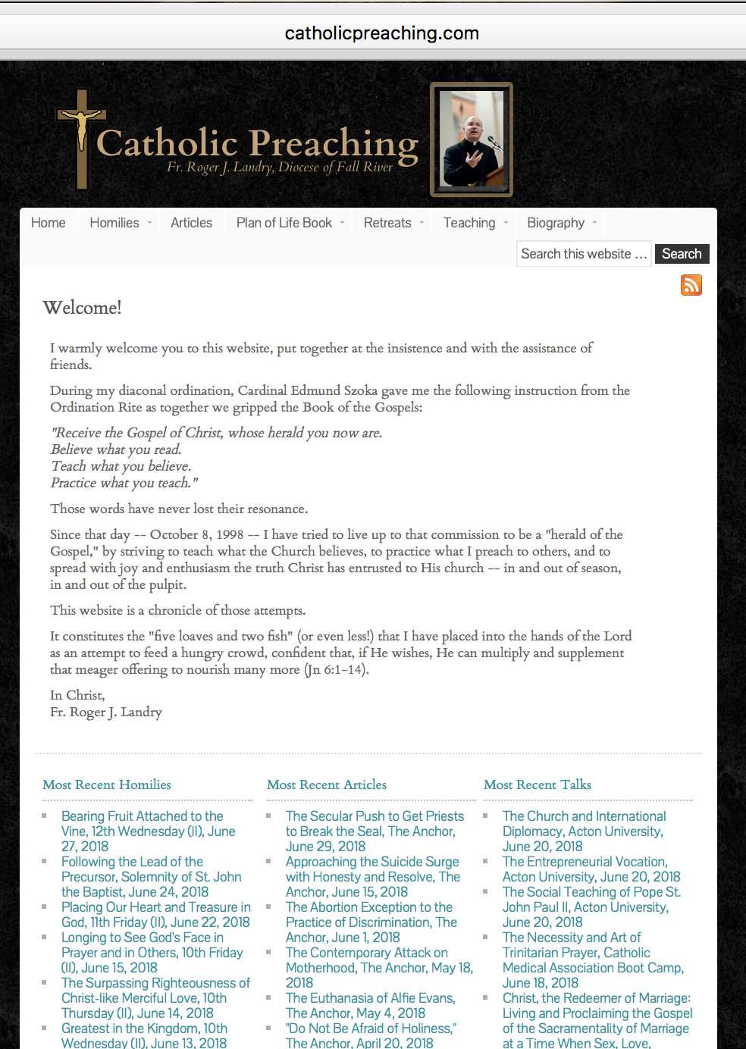
For a copy of this presentation
You may download a copy of this presentation in powerpoint or in PDF,
a copy of the notes for it,
or audio recordings
By going to
www.catholicpreaching.com and then clicking on the appropriate link under “Most Recent Talks”
Fr. Roger J. Landry Email: fatherlandry@catholicpreaching.com

