Slide 1
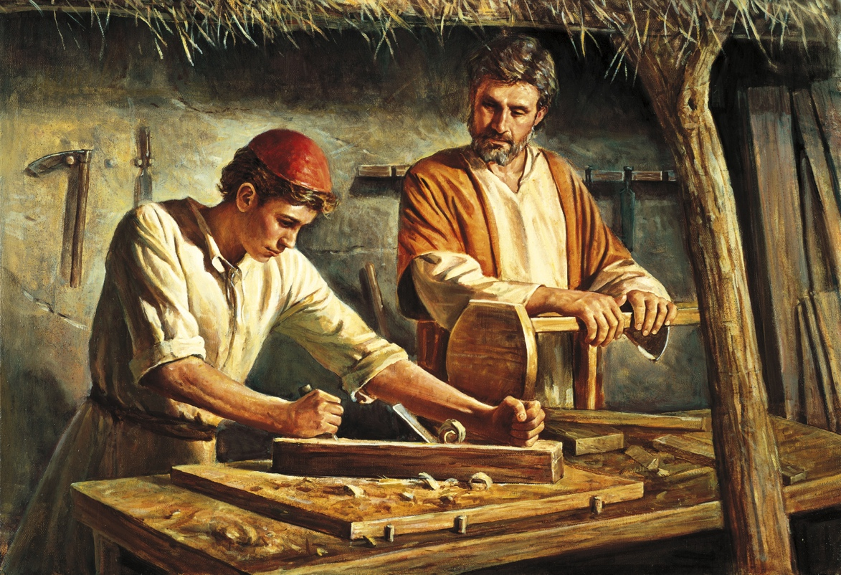
The Entrepreneurial Vocation
Fr. Roger J. Landry
Acton University
June 20, 2018

Slide 2
The Entrepreneurial Vocation
A sacred calling or an exaltation of the exploitative?
Jesus’ words about God and mammon, rich and poor
The new situation of appreciation
Purpose of the Talk
To nourish the understanding of those engaged in business so that they may live out their vocation more ardently;
To help those in ministry or future ministry support better those in business and strengthen them to live out their vocations to the full.
To assist all of us to see that there’s supposed to be an entrepreneurial dimension to every Christian vocation.

Slide 3
The Entrepreneurial Vocation
Structure of the Talk
The universal call to holiness
The universal vocation of every person to work
Characteristics of the specific vocation of the entrepreneur.
Some practical considerations about how to live out the entrepreneurial vocation faithfully.

Slide 4
The Universal Call to Holiness
The Vocation to Holiness
A vocation is a calling from God
The fundamental vocation every Christian has received through Baptism is be holy
“This is the will of God, your sanctification” (1Ths. 4:3 )
“You shall be holy, for I the LORD your God am holy” (Lev. 19:2 )
“Be perfect as your heavenly Father is perfect” (Mt 5:48)
Holiness is simply becoming more and more God-like.

Slide 5
The Universal Call to Work
God’s plan for work in the beginning, before and after the Fall
“Holiness is not something outside the bounds of normal everyday life. For God calls his people to lead holy lives within the ordinary circumstances in which they find themselves: at home, in the parish, in the workplace, at school, on the playing field.”
Increase and multiply, fill the earth and subdue it, exercise dominion (Gen 1)
Consequences of the Fall: pangs, sweat, toil but the vocation to work remains and becomes part of God’s plans for our redemptive healing.
The two dimensions of work
objective/subjective;
transitive/intransitive;
facere/agere
Spirituality of Work

Slide 6
The Universal Call to Work
St. John Paul II and the “Gospel of Work”
“The description of creation that we find in the very first chapter of the Book of Genesis, is also in a sense the first ‘gospel of work.’ For it shows what the dignity of work consists of: It teaches that man ought to imitate God, his creator, in working and in resting, because man alone has the unique characteristic of likeness to God.”
Jesus incarnates that Gospel of Work as a tekton for most of his life.
In his preaching, Jesus constantly refers to human work, to shepherds, farmers, doctors, sowers, householders, servants, stewards, fishermen, merchants, laborers, to cooking, sewing, baking. He compares the work of the kingdom to that of harvesters or fishermen. He refers to the work of scholars too.

Slide 7
The Entrepreneurial Vocation to Holiness
Some of the marks of the entrepreneurial vocation to holiness
Vocation of the Business Leader:
acceptance of risk
persistence in offering beneficial goods
creative planning combining resources
adaptation
St. Bernardine of Siena
efficiency
responsibility
hard work
risk-taking

Slide 8
The Entrepreneurial Vocation to Holiness
Some of the marks of the entrepreneurial vocation to holiness
Participation in God’s creative work
Participation in God’s providence
Good Stewards
Innovative Servants of others’ needs
Inventive
Mentor Others

Slide 9
Light from Sacred Scripture
Several Scriptural Passages that talk about the virtues of those who are rich:
Zacchaeus (Lk 19)
Joseph of Arimathea (Mt 27)
Good Samaritan (Lk 10)
Apostles
Parable of the Talents (Mt 25)

Slide 10
Parable of the Talents
The entrepreneur is the one who precisely “invests” the “talents” God has given him
God gives us talents to create, build up, multiply, invest
The wealth is always the Master’s. We are called to use it for the Kingdom.
The Master carefully assesses the natural abilities of each servant, but he is very generous to each
It is not immoral to profit from the resources, wit, time and work God has given us
God’s joy at and extraordinary reward for those who develop their talents:
“Well done, good and trustworthy servant; you have been trustworthy in a few things, I will put you in charge of many things; enter into the joy of your Lord.”

Slide 11
Parable of the Talents
The Problem with the Third Servant
Timidity
Wasting of the Gift
Idleness
Security over reasonable risk-taking. Out of fear of failure, he has refused even to try to succeed.
“Wicked and slothful”
No contrition
Actually blames the Master
Didn’t even try.

Slide 12
Parable of the Talents
The importance of subsidiarity, solidarity and trust
Trust: The Master allows his servants to decide upon the best manner of investment. He doesn’t micromanage, but unleashes the gift
Subsidiarity: the flourishing of human beings entails the best use of their intelligence and freedom.
Solidarity: In a workplace, the more participatory it, the more likely workers will develop.
God has exercised subsidiarity, solidarity and trust in making human beings co-creators with God
Business leaders should seek to model a similar subsidiarity, solidarity and trust to uphold the full human dignity of employees

Slide 13
Parable of the Talents
Other Lessons
An unequal distribution of wealth as such is not unjust
Making a profit cannot be not equated with greed, but can and should be a proper use of the gift
What we see about the “reallocation of resources”:
A moral system is doesn’t try to make everyone the same but recognizes and tries to assist each person to use his or her talents to the fullest.
Macroeconomic lesson:
8 talents entrusted became 15
One person’s gain is not another’s expense.
In a genuine free market economy, the success of the rich does not come at the expense of the poor.

Slide 14
Living Well Vocation Well
Entrepreneurs are called to sanctity in business, to be good stewards of the Master.
Entrepreneurs must depend on God, receiving his gifts and responding to them.
Entrepreneurs must beware of all greed
Entrepreneurs must strive to maintain a unity of life
Entrepreneurs must strive to form a community of persons
Entrepreneurs must seek true solidarity with the poor
The entrepreneur is called to be charitable in his work and as a result of his work
Entrepreneurs ought not facilitate the metastasis of consumerism
Entrepreneurs must properly value rest and take it.

Slide 15
Conclusion
“The vocation of the business person is a genuine human and Christian calling. Its importance in the life of the Church and in the world economy can hardly be overstated” (The Vocation of the Business Leader).
Every vocation requires a free and responsible answer.
“Much will be required of the person entrusted with much” (Lk 12:48)
The Vocation of the Entrepreneur is to become a living commentary of the first two servants in the Parable of the Talents

Slide 16
Bibliography
John Paul II, Laborem Exercens, http://w2.vatican.va/content/john-paul-ii/en/encyclicals/documents/hf_jp-ii_enc_14091981_laborem-exercens.html
John Paul II, Centesimus Annus, http://w2.vatican.va/content/john-paul-ii/en/encyclicals/documents/hf_jp-ii_enc_01051991_centesimus-annus.html
John Paul II, Sollicitudo Rei Socialis, http://w2.vatican.va/content/john-paul-ii/en/encyclicals/documents/hf_jp-ii_enc_30121987_sollicitudo-rei-socialis.html
John Paul II, Speech to the Members of the Christian Union of Entrepreneurs and Directors, December 14, 1985, https://w2.vatican.va/content/john-paul-ii/it/speeches/1985/december/documents/hf_jp-ii_spe_19851214_membri-ucid.html
John Paul II, Speech to Entrepreneurs and Economic Agents, May 22, 1983, https://w2.vatican.va/content/john-paul-ii/it/speeches/1983/may/documents/hf_jp-ii_spe_19830522_imprenditori-milano.html
Benedict XVI, Caritas in Veritate, http://w2.vatican.va/content/benedict-xvi/en/encyclicals/documents/hf_ben-xvi_enc_20090629_caritas-in-veritate.html
Pope Francis, Evangelii Gaudium, http://w2.vatican.va/content/francesco/en/apost_exhortations/documents/papa-francesco_esortazione-ap_20131124_evangelii-gaudium.html
Pope Francis, Laudato Si’, http://w2.vatican.va/content/francesco/en/encyclicals/documents/papa-francesco_20150524_enciclica-laudato-si.html
Pope Francis, Speech to the Joint Session of the Congress of the United States, https://w2.vatican.va/content/francesco/en/speeches/2015/september/documents/papa-francesco_20150924_usa-us-congress.html
The Vocation of the Business Leader, Pontifical Council for Justice and Peace, https://www.stthomas.edu/media/catholicstudies/center/ryan/publications/publicationpdfs/vocationofthebusinessleaderpdf/PontificalCouncil_4.pdf
Fr. Robert Sirico, The Entrepreneurial Vocation, http://www.marketsandmorality.com/index.php/mandm/article/view/608/598
Fr. Robert Sirico, “The Entrepreneurial Vocation,” http://www.acton.org/public-policy/business-society/entrepreneurship/entrepreneurial-vocation
Fr. Robert Sirico, “The Biblical Case for Entrepreneurship” http://www.acton.org/pub/religion-liberty/volume-11-number-1/biblical-case-entrepreneurship
Fr. Robert Sirico, “The Entrepreneur as Servant,” http://www.acton.org/pub/religion-liberty/volume-6-number-2/entrepreneur-servant
Fr. Robert Sirico, “A Worthy Calling,” http://www.acton.org/public-policy/business-society/entrepreneurial-voc/worthy-calling
Fr. Robert Sirico, “Saint Businessman,” http://www.acton.org/public-policy/business-society/entrepreneurial-voc/saint-businessman
William J. Toth, The Entrepreneurial Calling: Perspectives from Rahner, https://www.stthomas.edu/media/catholicstudies/center/documents/businessasacallingpdf/04Toth.pdf
Rob Tribken, The Image of God and the Entrepreneurial Vocation, http://fieldnotesmagazine.depree.org/the-image-of-god-and-the-entrepreneurial-vocation/

