Slide 1
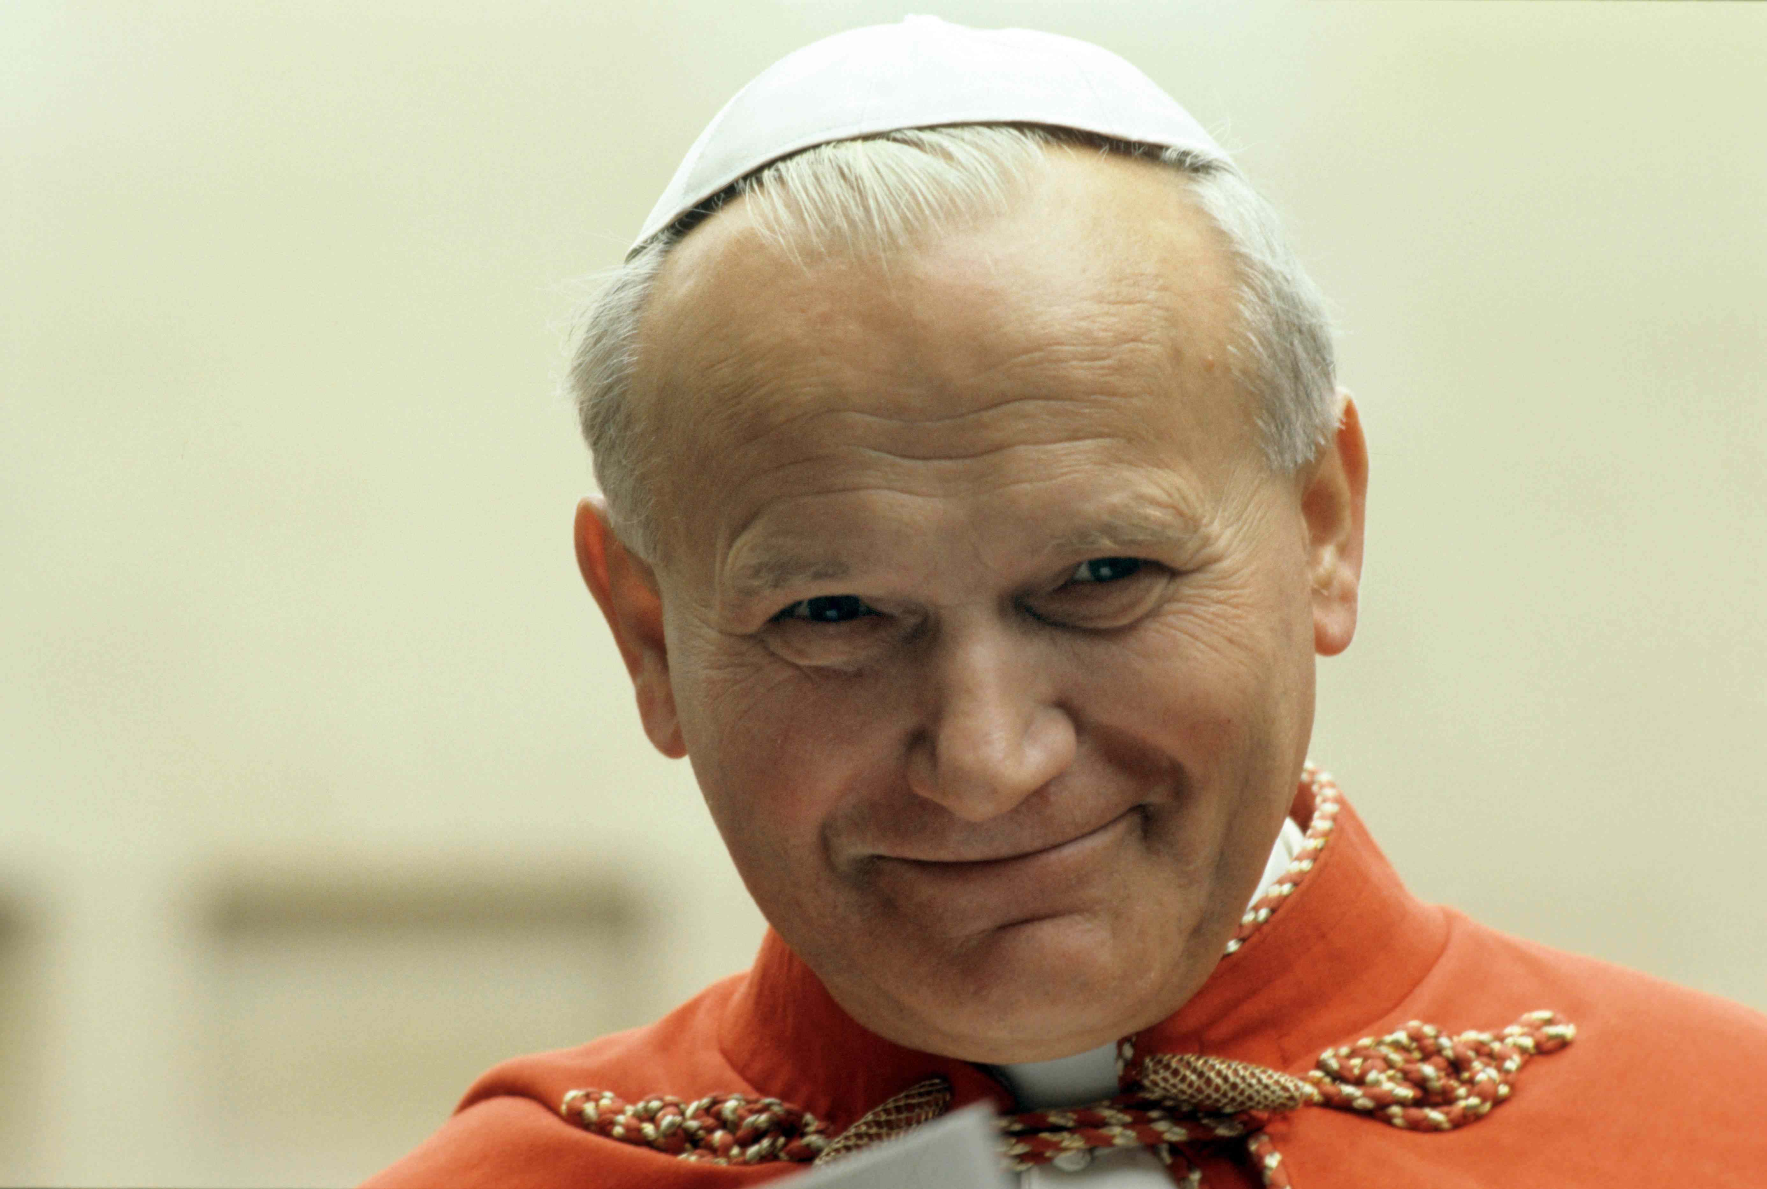
The Social Teaching of St. John Paul II
Father Roger J. Landry
Acton University
June 20, 2018

Slide 2
Preceding History
To understand the quantum leap of John Paul II’s social teaching, we need to know a little of what preceded it:
Rerum Novarum (Leo XIII, 1891)
Quadragesimo Anno (Pius XI, 1931)
Mater et Magistra (Pope John XXIII, 1961)
Gaudium et Spes (Vatican II, 1965)
Popolorum Progressio (Paul VI, 1967)

Slide 3
Scope of Catholic Social Teaching
The Compendium of the Social Doctrine of the Catholic Church (published in 2004 and authorized by John Paul II) lists several themes of the Church’s social teaching:
Marriage and Family
Human Work (the dignity of work, right to work, rights of workers, solidarity)
Economic Life (morality and the economy, private initiative and business initiative)
Political Community (authority, democratic system, civil society, interaction with religious communities)
International Community (fundamental rules, organization, cooperation for development)
The Environment
Peace (fruit of justice and love; it’s opposite is war)
We will focus above all on “economic subjects” which fundamentally involve human work, economic life, the political community as well as culture.

Slide 4
Deeper Anthropological & Biblical Re-Readings of CST
John Paul II’s Christological theological anthropology
Redemptor Hominis (1979) as the program for his pontificate and his social teaching.
Antecedents in Gaudium et Spes.
Christ fully reveals man to himself and makes his supreme calling clear (GS 22):
Man cannot discover himself except in the sincere gift of self (GS 24)

Slide 5
Deeper Anthropological & Biblical Re-Readings of CST
Applications of this theological anthropology to other areas of his pontificate
Human Sexuality
God’s Mercy
Dignity of Women
Family
Moral Theology
Faith and Reason
Protection of Human Life
Ecumenism
Art
Priestly Formation and Priestly Life
Human Suffering

Slide 6
Deeper Anthropological & Biblical Re-Readings of CST
Applications of this theological anthropology within his three major social encyclicals.
Laborem Exercens (1981)
Sollicitudo Rei Socialis (1987)
Centesimus Annus (1991)
The Compendium shows how Pope John Paul II provided the theological-moral nature for the Church’s social teaching.
His social teaching did not sound like mere public policy announcements
Rather it seemed very much like an application of the Gospel

Slide 7
John Paul II’s Three Social Encyclicals
Laborem Exercens (1981)
Sollicitudo Rei Socialis (1987)
Centesimus Annus (1991)

Slide 8
Laborem Exercens
Background
Summary of Core Teachings
Work is a fundamental dimension of man’s life on earth
The primary basis for the value of work is man himself
Jesus, the way of the Church, who fully reveals man to himself, reveals the fundamental redemptive meaning of human work.
Men and women cannot be treated as mechandise or“objects” but are “subjects” at the work place. Otherwise their work becomes alienating. The Primacy of labor over capital.

Slide 9
Sollicitudo Rei Socialis
Background
Summary of Core Teachings
Expansion of the “subjectivity” of work, found in Laborem exercens, to all citizens and members of organizations
Globalization, unrestricted by ethical principles, will wreak havoc on third world peoples.
A theologically grounded theory of human development that takes economics seriously but emphasizes the primary of the spiritual.
Conversion, particularly on the part of the powerful, is needed.
Conversion is also necessary on the part of developing countries, to eliminate corruption, dictatorial and authoritarian forms of government.

Slide 10
Centesimus Annus
Background
Summary of Core Teachings
The fall of communism was above all because of a distorted anthropology that tried to understand man exclusively at the level of material desires while excluding spiritual values.
The Free Economy and the distinction between “good” and “bad” capitalism (CA 42)
The free and virtuous society is a network or complex of three parts:
a democratic political community
a free economy and
a vibrant, public moral culture.

Slide 11
Centesimus Annus
Summary of Core Teachings
Freedom is intrinsically tied to moral truth, and hence truth and training in authentic freedom are essential for Democracy.
Poverty is essentially a problem of exclusion
There are some important goods that cannot be satisfied by market forces.
A need for the development of a true economic personalism (CA 30-43)
Principle cause of wealth is the person and his ideas
The person works within a community
Work involves a practical realism
Man’s vulnerability to sin must not be forgotten

Slide 12
Further Reading
Compendium of the Social Doctrine of the Church, Pontifical Council for Justice and Peace, 2004.
The Social Agenda: A Collection of Magisterial Texts, Pontifical Council for Justice and Peace, 2000.
Pope St. John Paul II
Centesimus Annus, 1991
Laborem Exercens, 1981
Sollicitudo Rei Socialis, 1987
Pope Benedict XVI
Deus Caritas Est, 2005 (19-42)
Caritas in Veritate, 2009.
Inaugural Session of the Fifth General Conference of CELAM, part IV, “Social and Political Problems”
Pope Francis
Evangelii Gaudium, 2013 (176-258)
Laudato Si’, 2015

