Slide 1
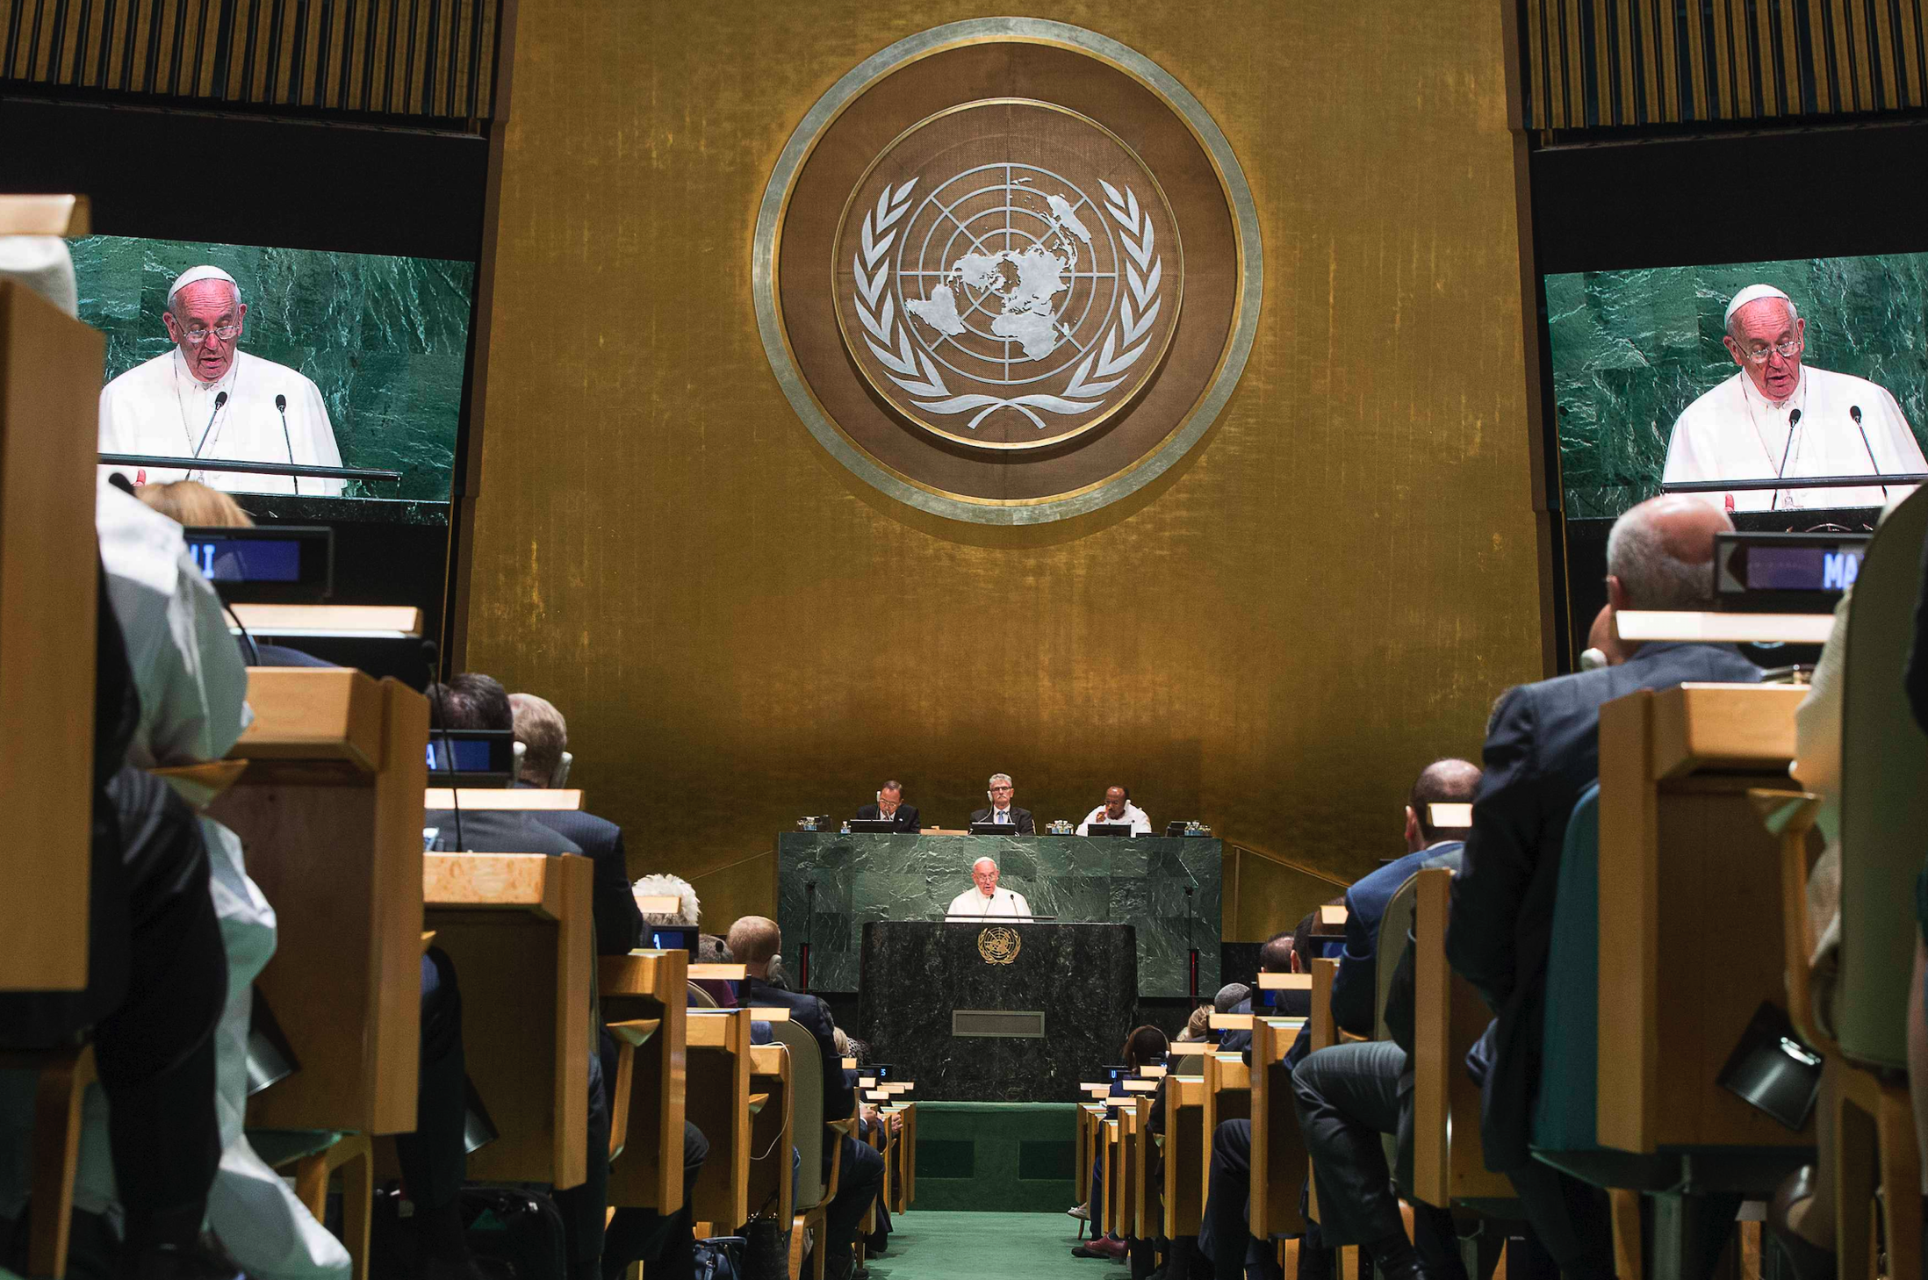
The United Nations and Human Trafficking: How the Holy See Engages the Discussion and Work
Fr. Roger J. Landry
Permanent Observer Mission of the
Holy See to the United Nations
Louisiana Summit on Modern Slavery and Human Trafficking
May 9, 2018
The Church and International Diplomacy
Fr. Roger J. Landry • Acton University • June 20, 2018

Slide 2
The Church and International Diplomacy
Mainly focused on the work of the Catholic Church, which has international juridical personality as a sovereign state and participates formally in bilateral and multilateral diplomatic work
Biblical Ground
Salt of the Earth (Mt 5:13)
Light of the World (Mt 5:14)
Leaven that makes the whole dough rise (Mt 13:33)
Caesar and God (Mt 22:21)
Genesis

Slide 3
Short History of Diplomacy
Definition of Diplomacy
Amarna Letters between Egyptian Pharoah and Amurru Leaders in Canaan (14th Century BC)
The peace treaty in 1274 BC between the Pharoah and the Ruler of the Hittites following the battle of Kadesh
Sun Tzu, 6th Century BC, The Art of War
Greek proxenoi (“instead of a foreigner”)
Modern diplomacy begins 13th Century AD in Northern Italy
Rupture of the French Revolution and the 1815 Council of Vienna
Growth of Multi-lateral diplomacy

Slide 4
Brief Introduction to Holy See Diplomacy
Definition of Sancta Sedes
Distinction from Vatican City State
Distinction from Catholic Church
Apocrisarii, Legati, Nuntii
Development of the Civil authority of the Pope
The Period between 1870-1929

Slide 5
Survey of the Holy See’s Diplomatic Profile
The Holy See has diplomatic relations with 183 countries:
Albania (7 September 1991), Algeria (6 March 1972), Andorra (16 June 1995), Angola (8 July 1997), Antigua and Barbuda (15 December 1986), Argentina (1877), Armenia (23 May 1992), Australia (24 March 1973), Austria (9 August 1946*), Azerbaijan (23 May 1992), Bahrain (12 January 2000), Bangladesh (25 September 1972), Barbados (19 April 1979), Belarus (11 November 1992), Belgium (1835), Belize (9 March 1983), Benin (29 June 1971), Bolivia (1877), Bosnia and Herzegovina (18 August 1992), Botswana (4 November 2008), Brazil (1829), Bulgaria (6 December 1990), Burkina Faso (14 June 1973), Burundi (11 February 1963), Cambodia (25 March 1994), Cameroon (27 August 1966), Canada (16 October 1969), Cape Verde (12 May 1976), Central African Republic (13 May 1967), Chad (28 November 1988), Chile (1877), China (23 October 1942), Colombia (26 November 1835), Congo (Democratic Republic of the (31 January 1977), Congo (Republic of the (16 February 1963), Cook Islands (29 April 1999), Costa Rica (1908), Croatia (8 February 1992), Cuba (2 September 1935), Cyprus (31 January 1973), Czech Republic (19 April 1990*), Denmark (2 August 1982), Djibouti (20 May 2000), Dominica (1 September 1981), Dominican Republic (1881), East Timor (20 May 2002), Ecuador (1877), Egypt (23 August 1947), El Salvador (1922), Equatorial Guinea (24 December 1981), Eritrea (15 July 1995), Estonia (3 October 1991*), Ethiopia (20 March 1957), Fiji (12 September 1978), Finland (1942), France (16th Century)

Slide 6
Survey of the Holy See’s Diplomatic Profile
The Holy See has diplomatic relations with 183 countries:
Gabon (31 October 1967), Georgia (23 May 1992), Germany (1920), Ghana (20 November 1975), Great Britain (16 January 1982), Greece (17 July 1979), Grenada (17 February 1979), Guatemala (16 March 1936), Guinea (21 June 1986), Guinea Bissau (12 July 1986), Guyana (9 June 1997), Haiti (1881), Honduras (1908), Hungary (9 February 1990*), Iceland (October 1976), India (12 June 1948), Indonesia (13 March 1950), Iran (2 May 1953), Iraq (26 August 1966), Ireland (27 November 1929), Israel (15 June 1994), Italy (24 June 1929), Ivory Coast (26 October 1970), Jamaica (20 July 1979), Japan (March 1942), Jordan (3 March 1994), Kazakhstan (17 October 1992), Kenya (19 June 1965), Kiribati (10 April 1995), Korea (Republic of (11 December 1963), Kuwait (21 October 1968), Kyrgyzstan (27 August 1992), Latvia (1 October 1991*), Lebanon (November 1946), Lesotho (11 March 1967), Liberia (15 December 1927), Libya (10 March 1997), Liechtenstein (28 August 1985), Lithuania (30 September 1991*), Luxembourg (1891), Macedonia ((Former Yugoslav Republic of) (21 December 1994), Madagascar (24 December 1966), Malawi (5 February 1966), Mali (29 October 1979), Malta (15 December 1965), Mauritania (Islamic Republic of (9 December 2016), Mauritius (9 March 1970), Mexico (21 September 1992), Micronesia (26 January 1994), Moldova (23 May 1992), Monaco (1875), Mongolia (4 April 1992), Montenegro (16 December 2006), Morocco (15 January 1976), Mozambique (14 December 1995), Myanmar (5 April 2017)

Slide 7
Survey of the Holy See’s Diplomatic Profile
The Holy See has diplomatic relations with 183 countries:
Namibia (12 September 1995), Nauru (1 June 1992), Nepal (10 September 1983), New Zealand (20 June 1973), Nicaragua (1908), Niger (20 July 1971), Nigeria (20 November 1975), Norway (2 August 1982), Pakistan (6 October 1951), Palau (17 December 1998), Panama (1923), Papua New Guinea (7 March 1977), Paraguay (1877), Peru (1877), Poland (17 July 1989*), Portugal (XVIth Century), Qatar (18 November 2002), Romania (15 May 1990*), Rwanda (6 June 1964), Saint Kitts and Nevis (19 July 1999), Saint Lucia (1 September 1984), Saint Vincent and the Grenadines (16 April 1990), Samoa (10 June 1994), San Marino (April 1926), São Tomé and Príncipe (21 December 1984), Senegal (17 November 1961), Serbia (14 August 1970*), Seychelles (27 July 1984), Sierra Leone (30 July 1996), Singapore (24 June 1981), Slovakia (1 January 1993*), Slovenia (8 February 1992), Solomon Islands (9 May 1984), South Africa (5 March 1994), Spain (15th Century), Sri Lanka (6 September 1975), Suriname (16 February 1994), Swaziland (11 March 1992), Sweden (2 August 1982), Switzerland (16th Century), Syria (21 February 1953), Tajikistan (15 June 1996), Tanzania (19 April 1968), Thailand (28 April 1968), The Bahamas (27 July 1979), The Gambia (7 June 1978), The Marshall Islands (30 December 1993), The Netherlands (1829), The Philippines (8 April 1951)

Slide 8
Survey of the Holy See’s Diplomatic Profile
The Holy See has diplomatic relations with 183 countries:
The Russian Federation (9 December 2009), The Sudan (29 April 1972), The United Arab Emirates (31 May 2007), The United States of America (10 January 1984), Togo (21 April 1981), Tonga (24 August 1994), Trinidad and Tobago (23 July 1978), Tunisia (22 March 1972), Turkey (25 January 1960), Turkmenistan (10 July 1996), Uganda (1 September 1966), Ukraine (8 February 1992), Uruguay (1877), Uzbekistan (17 October 1992), Vanuatu (20 July 1994), Venezuela (1881), Yemen (13 October 1998), Zambia (15 May 1965), Zimbabwe (26 June 1980)
The Holy See also has diplomatic relations with the European Union (10 November 1970), The Sovereign Military Order of Malta (February 1930), and relations of a special nature with Palestine (25 October 1994).

Slide 9
Survey of the Holy See’s Diplomatic Profile
The Holy See participates in various Intergovernmental Organizations and Bodies and International Programmes, including:
United Nations Organization, New York, Observer; UNOG, United Nations Office in Geneva, Geneva, Observer; UNOV, United Nations Office in Vienna, Vienna, Observer; UNHCR, United Nations High Commissioner for Refugees, Geneva, Member of the Executive Committee; UNCTAD, United Nations Conference on Trade and Development, Geneva, Member; WIPO, World Intellectual Property Organization, Geneva, Member; IAEA, International Atomic Energy Agency, Vienna, Member; OPCW, Organization for the Prohibition of Chemical Weapons, The Hague, Member; CTBTO, Preparatory Commission for the Comprehensive Nuclear-Test Ban Treaty Organization, Vienna, Member; ICMM, International Committee of Military Medicine, Brussels, Member; FAO, United Nations Food and Agriculture Organization, Rome, Observer; ILO, International Labour Organization, Geneva, Observer; WHO, World Health Organization, Geneva, Observer; UNESCO, United Nations Educational, Scientific and Cultural Organization, Paris, Observer; UNIDO, United Nations Industrial Development Organization, Vienna, Observer; IFAD, International Fund for Agricultural Development, Rome, Observer; UNWTO, World Tourist Organization, Madrid, Observer; WMO, World Meteorological Organization, Geneva, Observer; WTO, World Trade Organization, Geneva, Observer; UNDP, United Nations Development Program, New York, Observer; UN-HABITAT, United Nations Centre for Human Settlements, Nairobi, Observer; UNEP, United Nations Environment Programme, Nairobi, Observer; WFP, World Food Programme, Rome, Observer; INTOSAI, International Organization of Supreme Audit Institutions, Vienna, Member; CIEC, International Commission on Civil Status, Strasbourg, Observer; UL, Latin Union, Paris, Permanent Guest; OSCE, Organization for Security and Co-operation in Europe, Vienna, Member; CE, Council of Europe, Strasbourg, Observer; AU, African Union, Addis Abeba, Non-Member Accredited state; OAS, Organization of American States, Washington, Observer; LAS, League of Arab States, Cairo, Member of a bilateral agreement of cooperation; AALCO, Asian-African Legal Consultative Organization, New Delhi, Guest; UNIDROIT, International Institute for the Unification of Private Law, Rome, Member

Slide 10
Survey of the Holy See’s Diplomatic Profile
The Vatican City State participates in various International and Intergovernmental Organizations, including :
UPU, Universal Postal Union, Bern, Member
ITU, International Telecommunication Union, Geneva, Member
IGC, International Grains Council, London, Member
ITSO, International Telecommunications Satellite Organization, Washington D.C., Member
EUTELSAT IGO, European Telecommunication Satellite Organization, Paris, Member
CEPTE, European Conference of Postal and Telecommunications, Copenhagen, Member
IISA, International Institute of Administrative Sciences, Brussels, Member

Slide 11
The Holy See’s Goals of Engagement
Not concerned principally with what most States are, e.g., borders, economic benefits, military security.
Articulating the ethical principles that ought to underpin the social and political order on the basis of universally applicable principles that are as real as the physical elements of the natural environment.

Slide 12
The Holy See at the United Nations
Initial Concerns
Overlap of four UN Pillars with Catholic Social Teaching
Observer Status
Papal Visits to the UN
Need for the Institution
Need for Reform of the Institution
“Catholicity” of the UN

Slide 13
Perennial and Present Priorities of Holy See Diplomacy
Peace
Freedom, especially religious freedom and freedom of conscience
Fundamental human rights
Intercultural dialogue
Support for democratic institutions
Development and seeking to lift the poor out of poverty.
Care for migrants and mefugees
Care for our common home

Slide 14
The Social Content of the Kerygma
Pope Francis in Evangelii Gaudium (177-181)
The kerygma has a clear social content
The Gospel has an immediate moral implication centered on charity
Our redemption has a social dimension because God, in Christ, redeems not only the individual person, but also the social relations existing between men.
Reading the Scriptures also makes it clear that the Gospel is not merely about our personal relationship with God. Nor should our loving response to God be seen simply as an accumulation of small personal gestures to individuals in need, a kind of “charity à la carte”, or a series of acts aimed solely at easing our conscience. The Gospel is about the kingdom of God (cf. Lk 4:43); it is about loving God who reigns in our world. To the extent that he reigns within us, the life of society will be a setting for universal fraternity, justice, peace and dignity. Both Christian preaching and life, then, are meant to have an impact on society.
True Christian hope, which seeks the eschatological kingdom, always generates history.
These are the convictions that undergird the International Diplomatic work of the Holy See, as part of the Church’s seeking to be the salt of the earth, the life of the world, and the leaven that raises the world.

Slide 15
For a copy of this presentation
You may download a copy of this presentation in powerpoint or in PDF by going to catholicpreaching.com and then clicking on the appropriate link under “Recent Talks”
Fr. Roger J. Landry Permanent Observer Mission of the Holy See to the UN rlandry@holyseemission.org 212.370.7885

