Slide 1
The United Nations and Human Trafficking: How the Holy See Engages the Discussion and Work
Fr. Roger J. Landry
Permanent Observer Mission of the
Holy See to the United Nations
Louisiana Summit on Modern Slavery and Human Trafficking
May 9, 2018

Slide 2
The UN and Human Trafficking
Attuned and focused to the scourge of trafficking
Various central documents and actions
Protocol to Prevent, Suppress and Punish Trafficking in Persons, especially Women and Children (part of the UN Convention against Transnational Crime, adopted in 2000, entered into force 2003)
Global Plan of Action to Combat Trafficking in Persons (2010)
Transforming Our World: The 2030 Agenda for Sustainable Development (2015)
The Global Compact for Safe, Orderly and Regular Migration and the Global Compact for Refugees (2018)

Slide 3
The UN and Human Trafficking
Protocol to Prevent, Suppress and Punish Trafficking in Persons, especially Women and Children
Defines the crime of trafficking in human beings: the act (e.g., transport, recruitment), means (e.g., force, fraud) and purpose (e.g., forced labor, sexual exploitation)
Prohibits the trafficking of children (under 18) and facilitates their return
Suspends rights of parents and care givers if they traffic
Ensures that trafficked persons are not punished for offenses related to the situation, such as prostitution or immigration violations
Ensures that victims are protected from deportation or return when there’s a security risk to them or to their family.
Considers granting temporary or permanent residence in exchange for testimony against traffickers, or on humanitarian grounds
Provides for criminal penalties for aggravated offenses like trafficking in children or complicity by state officials
Provides for confiscation of proceeds of trafficking for the benefit of trafficked persons.

Slide 4
The UN and Human Trafficking
Global Plan of Action to Combat Trafficking in Persons (2010)
Four Ps:
Prevention of Trafficking in Persons
Protection of and Assistance of Victims of trafficking in persons
Prosecution of crimes of trafficking in persons
Strengthening of Partnerships against trafficking in persons.
Re-appraised in 2017

Slide 5
The UN and Human Trafficking
Political declaration on the implementation of the United Nations Global Plan of Action to Combat Trafficking in Persons (2017)
“Strong political will to take decisive action to end this heinous crime wherever it may occur”
“Address the social, economic, cultural, political and other factors that make people vulnerable to trafficking in persons”
Human trafficking “constitutes a crime and a serious threat to human dignity and physical integrity, and a challenge to sustainable development”
The Crucial importance of universal ratification of the United Nations Convention against Transnational Organized Crime and the Protocol to Prevent, Suppress and Punish Trafficking in Persons, Especially Women and Children
“We express solidarity with and compassion for victims and survivors.… We will provide appropriate care, assistance and services for their recovery and rehabilitation, working with civil society and other relevant partners. … We will also undertake appropriate measures for access to justice and protections for victims in criminal justice processes.” (continued)

Slide 6
The UN and Human Trafficking
Political declaration on the implementation of the United Nations Global Plan of Action to Combat Trafficking in Persons (2017)
“We commit to intensify our efforts to prevent and address, with a view to eliminating, the demand that fosters trafficking, especially of women and girls, for all forms of exploitation”
“We reaffirm our commitment to continue our efforts to criminalize trafficking in persons in all its forms, and to strengthen cooperation and coordination among Member States in countries of origin, transit and destination in order to disrupt and dismantle criminal networks involved in such crimes “
“The scale of global resourcing to fight trafficking in persons does not match the scale of the challenge”
“We reaffirm that the crime of trafficking in persons for the purpose of organ removal constitutes a form of exploitation and an offence against the human dignity of the victims”
“We reiterate, in the strongest terms possible, the importance of strengthening collective action by Member States to end trafficking in persons, … including non-governmental organizations, academic institutions and faith-based organizations, as well as national human rights institutions, where they exist, with regard to the Paris Principles”

Slide 7
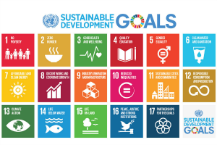
The UN and Human Trafficking
Transforming Our World: The 2030 Agenda for Sustainable Development (2015)
17 Goals, 169 Targets.
5.2 — Eliminate all forms of violence against all women and girls in the public and private spheres, including trafficking and sexual and other types of exploitation.
8.7 — Take immediate and effective measures to eradicate forced labor, end modern slavery and human trafficking and secure the prohibition and elimination of the worst forms of child labor, including recruitment and use of child soldiers, and by 2025 end child labor in all its forms.
16.2 — End abuse, exploitation, trafficking and all forms of violence against and torture of children.

Slide 8
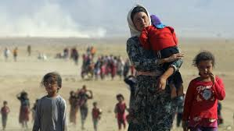
The UN and Human Trafficking
Trafficking in the vulnerable situation of refugees and migrants
The New York Declaration for Refugees and Migrants (2016)
The Global Compact for Safe, Orderly and Regular Migration
The Global Compact on Refugees

Slide 9
The UN and Human Trafficking
The New York Declaration for Refugees and Migrants (2016)
“Refugees and migrants in large movements often face a desperate ordeal. Many take great risks, embarking on perilous journeys, which many may not survive. Some feel compelled to employ the services of criminal groups, including smugglers, and others may fall prey to such groups or become victims of trafficking.”
“We recognize and will address, in accordance with our obligations under international law, the special needs of all people in vulnerable situations who are travelling within large movements of refugees and migrants, including … victims of human trafficking.”
“Reaffirming the importance of the United Nations Convention against Transnational Organized Crime and the two relevant Protocols thereto, we encourage the ratification of, accession to and implementation of relevant international instruments on preventing and combating trafficking in persons and the smuggling of migrants”
“We recognize that refugees and migrants in large movements are at greater risk of being trafficked and of being subjected to forced labor. We will, with full respect for our obligations under international law, vigorously combat human trafficking and migrant smuggling with a view to their elimination, including through targeted measures to identify victims of human trafficking or those at risk of trafficking. We will provide support for the victims of human trafficking. We will work to prevent human trafficking among those affected by displacement.
“With a view to disrupting and eliminating the criminal networks involved, we will review our national legislation to ensure conformity with our obligations under international law on migrant smuggling, human trafficking and maritime safety. We will implement the United Nations Global Plan of Action to Combat Trafficking in Persons. We will establish or upgrade, as appropriate, national and regional anti-human trafficking policies.”

Slide 10
The UN and Human Trafficking
The Global Compact for Safe, Orderly and Regular Migration (2018, negotiations ongoing)
Preamble mentions that the Global Compact rests, among other foundational documents, on the United Nations Convention against Transnational Organized Crime including the Protocol to Prevent, Suppress and Punish Trafficking in Persons Especially Women and Children and the Protocol against the Smuggling of Migrants by Land, Sea and Air.
22 Objectives
Objective 9 — Strengthen the transnational response to smuggling of migrants
Objective 10 — Prevent and combat trafficking in persons in the context of international migration

Slide 11
The UN and Human Trafficking
The Global Compact for Safe, Orderly and Regular Migration Objective 10 — Prevent and combat trafficking in persons in the context of international migration
We commit to reduce legal and practical barriers to preventing and combating trafficking in persons in the context of international migration by strengthening international cooperation and ending impunity of trafficking networks. We further commit to enhance the identification and protection of, and assistance to migrants who have become victims of trafficking. In this regard, the following actions are instrumental:
Encourage signature, ratification, accession and implementation of the Protocol to Prevent, Suppress and Punish Trafficking in Persons Especially Women and Children, supplementing the United Nations Convention against Transnational Organized Crime (UNTOC)
Promote the implementation of the Global Plan of Action to Combat Trafficking in Persons and take into consideration the Toolkit to Combat Trafficking in Persons when developing and implementing national measures relating to trafficking in persons.
Monitor irregular migration routes which may be exploited by human trafficking networks to victimize smuggled or irregular migrants, and cooperate at bilateral, regional and cross-regional levels on investigation, prosecution of perpetrators, prevention, as well as on identification of, and protection and assistance to victims

Slide 12
The UN and Human Trafficking
The Global Compact for Safe, Orderly and Regular Migration Objective 10 — Prevent and combat trafficking in persons in the context of international migration
4. Share information and intelligence, including on the modus operandi, economic models and conditions driving trafficking networks, strengthen cooperation between all relevant actors, including financial intelligence units, regulators and financial institutions, to identify and disrupt financial flows, and enhance judicial cooperation and enforcement in order to increase conviction rates, ensure accountability and end impunity
5. Apply measures that address the particular vulnerabilities of women, men, girls and boys, regardless of their migration status, that have become or are at risk of becoming victims of trafficking in persons and modern slavery by facilitating access to reporting, focusing on prevention, identification, protection and assistance, and addressing specific forms of abuse, such as sexual exploitation
6. Ensure that definitions of trafficking in persons used in legislation, migration policy planning and in judicial prosecutions are in accordance with international law, in order to distinguish between the crimes of trafficking in persons and smuggling of migrants
7. Strengthen legislation and procedures to enhance prosecution of traffickers, avoid criminalization of migrants for being victims of trafficking in persons, and ensure that protection and assistance to victims are not conditional upon cooperation with the authorities against suspected criminals
8. Provide migrants that have become victims of trafficking in persons with temporary or permanent residency and work permits for the purpose of allowing victims access to justice, including redress and compensation

Slide 13
The UN and Human Trafficking
Various Considerations
Nomenclature
“Human Trafficking” and “Trafficking in Persons”
Expressions in International Law, e.g., Protocol to Prevent, Suppress and Punish Trafficking in Persons Especially Women and Children, supplementing the United Nations Convention against Transnational Organized Crime (UNTOC)
“Modern Slavery”
1926 Slavery Convention
Slavery defined as “the status or condition of a person over whom any or all of the powers attaching to the right of ownership are exercised”
The slave trade was defined as “all acts involved in the capture, acquisition or disposal of a person with intent to reduce him to slavery; all acts involved in the acquisition of a slave with a view to selling or exchanging him; all acts of disposal by sale or exchange of a slave acquired with a view to being sold or exchanged, and, in general, every act of trade or transport in slaves.”
UK Modern Slavery Act 2015
Expression the Holy See Mission normally uses: “human trafficking and all forms of modern slavery”

Slide 14
The UN and Human Trafficking
Various Considerations
Declarationist Nominalism?
Pope Francis, 2015 Address to General Assembly: “Our world demands of all government leaders a will which is effective, practical and constant, concrete steps and immediate measures for … putting an end as quickly as possible to the phenomenon of social and economic exclusion, with its baneful consequences: human trafficking, the marketing of human organs and tissues, the sexual exploitation of boys and girls, slave labor, including prostitution…. Such is the magnitude of these situations and their toll in innocent lives, that we must avoid every temptation to fall into a declarationist nominalism that would assuage our consciences. We need to ensure that our institutions are truly effective in the struggle against all these scourges”
Political declarations
Emphasis on law enforcement
UN Office on Drugs and Crime
Much progress in terms of the adoption of the UN TIP Protocol in national legislation, but convictions are minimal.
Leadership and coordination
UN Office on Drugs and Crime
The Interagency Coordination Group against Trafficking in Persons (ICAT) (“policy forum” among 20 different UN departments, offices and agencies)
Group of Friends United Against Human Trafficking, 24 Member States, chaired by Belarus
Various Permanent Missions
Civil Society

Slide 15
The Holy See at the UN on Human Trafficking
The Work of the Church on Human Trafficking
The Holy See’s involvement is not new!
Vatican II condemned “slavery, prostitution, the selling of women and children, and disgraceful working conditions where people are treated as instruments of gain rather than free and responsible persons” as “infamies” that “poison human society, debase their perpetrators” and as “a supreme dishonor to the Creator” (Gaudium et Spes, 27).
St. John Paul II gave a lengthy address on the occasion of the International Conference, “Twenty-First Century Slavery: the Human Rights Dimension to the Trafficking in Human Beings,” May 15, 2002), saying:
“The issue of human trafficking must be addressed by promoting effective juridical instruments to halt this iniquitous trade, to punish those who profit from it, and to assist the reintegration of its victims.”
“The sexual exploitation of women and children is a particularly repugnant aspect of this trade, and must be recognized as an intrinsic violation of human dignity and rights. The disturbing tendency to treat prostitution as a business or industry not only contributes to the trade in human beings, but is itself evidence of a growing tendency to … reduce the rich mystery of human sexuality to a mere commodity.”
He urged that attention be given not only to the “significant political and juridical issues involved in responding to this modern plague,” but also to the “ethical questions” that fuel the market demand for human trafficking, namely, “the lifestyles and models of behavior, particularly with regard to the image of women, which generate what has become a veritable industry of sexual exploitation in the developed countries”

Slide 16
The Holy See at the UN on Human Trafficking
The Work of the Church on Human Trafficking
Pope Benedict XVI likewise condemned the “scourge of trafficking in human beings” in his 2006 Message for the World Day of Migrants and Refugees, saying that the world needed to combat the “trafficking in human beings, especially women, that flourishes where opportunities to improve their standard of living or even to survive are limited.”
He continued, “It becomes easy for the trafficker to offer his own ‘services’ to the victims, who often do not even vaguely suspect what awaits them. In some cases there are women and girls who are destined to be exploited almost like slaves in their work, and not infrequently in the sex industry, too.”
He specifically criticized the “the widespread hedonistic and commercial culture that encourages the systematic exploitation of sexuality” and in a particular way harms women and girls.

Slide 17
The Holy See at the UN on Human Trafficking
The Work of the Church on Human Trafficking
Pope Francis has taken papal involvement to a new level.
Hand-written note to Bishop Marcelo Sanchez Sorondo, Chancellor of the Pontifical Academies for Science and Social Sciences, in which he wrote, “I believe it would be good to examine human trafficking and modern slavery. Organ trafficking could be examined in connection with human trafficking. Many thanks, Francis.”
2014 Joint Declaration of Religious Leaders against Modern Slavery
Evangelii Gaudium (2013) and Laudato Sì’ (2015)
2015 Message for the World Day of Peace
UN General Assembly Address 2015
The Santa Marta Group

Slide 18
The Holy See at the UN on Human Trafficking
Pope Francis spoke out earlier this week (May 7, 2018) in a video message to the “Forum on modern forms of slavery” being held in Buenos Aires in which he said:
“Slavery is not something from other times. It is a practice that has deep roots and continues to manifest itself today and in many different ways: trafficking of human beings, exploitation of work through debt, exploitation of children, sexual exploitation and forced domestic work are some of the many forms. Each one is as serious and inhuman as the others.”
“According to some recent statistics, there would be more than 40 million people, men, but especially women and children, who suffer as a result of slavery. Just to give us an idea, imagine that if they lived in a single city, it would be the largest megalopolis on our planet and would have, more or less, four times the population of the entire urban area of Buenos Aires and Greater Buenos Aires.”
“Faced with this tragic reality, no one can wash their hands of it without being, in some way, an accomplice to this crime against humanity.”
Three tasks:
Break “the veil of indifference” through increasing awareness
Act in favor of those who have been enslaved: defending their rights, ensuring that those who have hurt them don’t escape justice.
Addressing the poverty that makes them vulnerable to exploitation through development, education, employment, etc.
“This immense task, which requires courage, patience and perseverance, demands a joint and global effort on the part of the different actors that make up society. The Churches must also play a role task in this.”

Slide 19
The Holy See at the UN on Human Trafficking
Emphases of the Permanent Observer Mission of the Holy See to the UN (in New York)
Negotiations
Address demand
Ensure focus on rescue, rehabilitation and reintegration
Address the underlying causes
Focus on the work of faith-based organizations, especially the work of women religious and charitable organizations
Conferences
Give far greater attention to these emphases

Slide 20
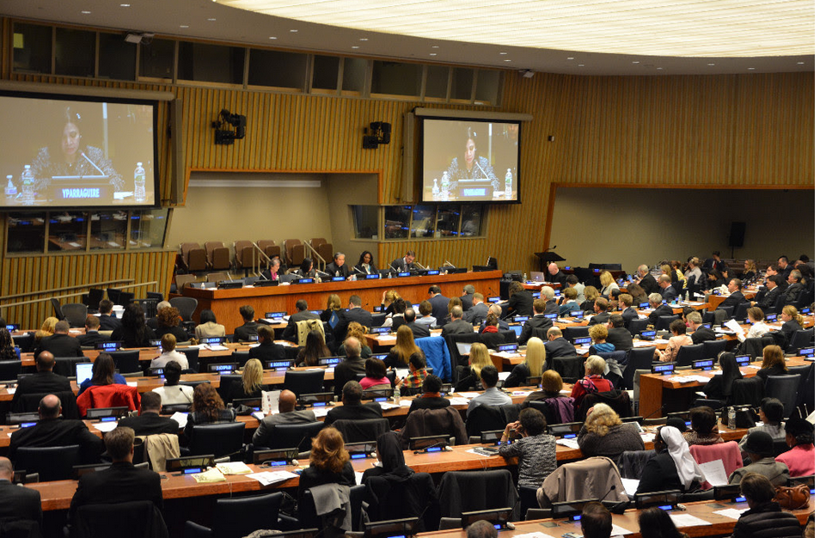
The Holy See at the UN on Human Trafficking
“Ending Human Trafficking by 2030: The Role of Global Partnerships in Eradicating Modern Slavery,” April 7, 2016
Co-sponsored with the Santa Marta Group, led by Cardinal Vincent Nichols and UK Independent Anti-Slavery Commission Kevin Hyland
Focused on the scope of the problem, what is being done to address it in a coordinated way, insights from member states and reactions from the floor.
Participation from Survivors, the President of the General Assembly, 13 Ambassadors, Ministers, Leaders from the UNODC, ILO, IOM, UN University, Freedom Fund, Media organizations, Government Ministers, Leading Women Religious including from RENATE, Bishop Sanchez Sorondo and more.
600 in attendance, including many leaders in the fight against trafficking from around the world.

Slide 21
The Holy See at the UN on Human Trafficking
“The Pastoral Care of Women and Girls Working or Living on the Street,” March 21, 2016
Co-sponsored with the London-based Women@theWell.
Standing Room Only in UNHQ Conference Room 11.
Designed to help women and girls on the street, many of whom are trafficked, all of whom are exploited, to get off the street and stay off the street.
UK Independent Anti-Slavery Commissioner Kevin Highland spoke about the macroscopic issues.
A religious spoke about the house she runs to provide the services necessary to help women escape from the streets and stay off of them.
A survivor of the streets from Dublin spoke about the abusive reality of prostitution, what was necessary for her to leave the streets, and the work she is doing to help liberate other women and girls.
An academic looked at the larger issues involved in terms of the human rights being violated in the exploitation of women and girls.

Slide 22
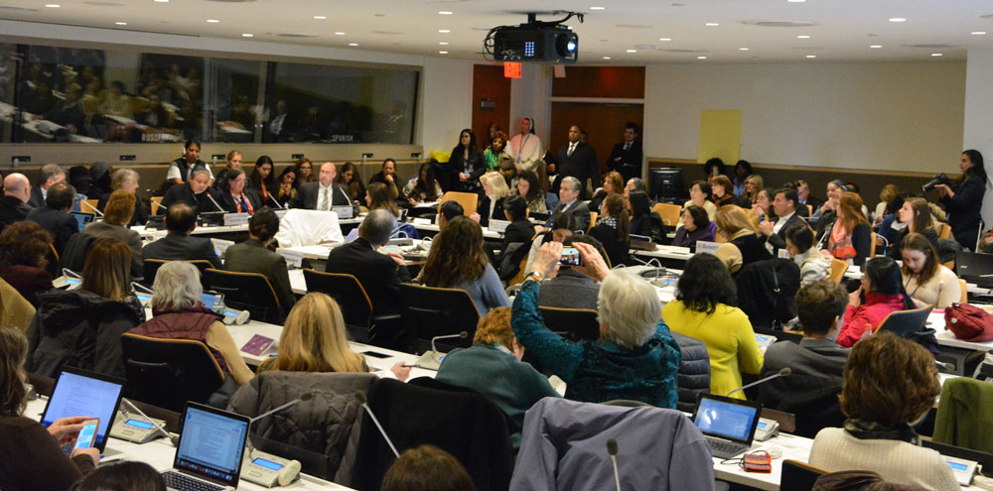
The Holy See at the UN on Human Trafficking
“Economically Empowering Trafficking Survivors to Stay Permanently Off the Streets,” March 22, 2017
Co-sponsored with the Permanent Observer Mission of the Sovereign Order of Malta and the Universal Peace Federation during the 61st Session of the Commission on the Status of Women.
Standing Room Only in UNHQ Conference Room 11.
Two religious women running rehabilitation centers for survivors spoke on best practices for rehabilitation, addressing addictions, poverty, lack of life skills, and the necessary psychological care.
Presentation by Operation Underground Railroad on rescuing people from the streets
Airline Ambassadors spoke on spotting and preventing trafficking.
An agent from the U.S. Department of Homeland Security focused on the dearth of safe-houses and many other issues from law enforcement to help survivors.
Several speakers spoke out about the need to address the demand and what that would involve.

Slide 23
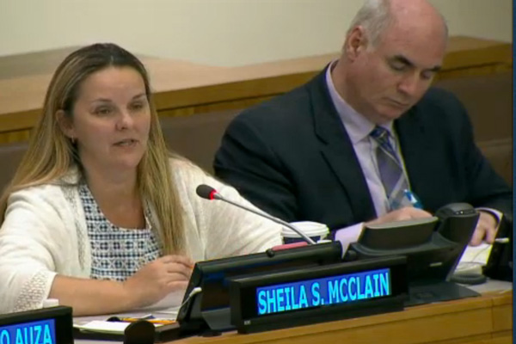
The Holy See at the UN on Human Trafficking
“Eliminating the Trafficking of Children and Youth,” July 13, 2017
\
Co-sponsored with NGO Committee to Stop Trafficking in Persons, Salesian Missions, The Greek Orthodox Archdiocese of America and ECPAT-USA.
300 people in UNHQ Conference Room 1.
UNODC focused on the status of human trafficking and particularly of the young.
A representative from the ILO spoke about trafficking children for labor.
A survivor spoke about her experience on the streets and about what she’s doing to help other victims.
A religious sister with her Ph.D. in trafficking examined the causes of child trafficking and remedies, particularly on giving voice to the victims
The director of anti-trafficking initiatives at Covenant House in New York described the situation of homeless trafficked youth.
The Executive director of ECPAT-USA described the use of the internet in trafficking young people.

Slide 24
The Holy See at the UN on Human Trafficking
“Preventing Human Trafficking among Rural Women and Girls ,” March 13, 2018
Co-sponsored with the Arise Foundation and Eight Religious NGOs — Mercy International Association, Mercy Global Action, Society of the Sacred Heart, Women@TheWell, Congregation of Our Lady of Charity of the Good Shepherd, Institute of the Blessed Virgin Mary, UNANIMA and the National Board of Catholic Women (UK).
560 people in UNHQ Conference Room 1.
A Survivor from the Philippines told her story of the way she was recruited into trafficking and how her family situation made that possible.
Religious women working in the Philippines, Australia, India and among the indigenous in Canada focused on push and pull factors involved in the trafficking of rural women and girls.
Specific call on the international community to give more directly to NGOs working to eradicate human trafficking on the ground rather than through big international organizations that have little impact beyond cities.

Slide 25
The Holy See at the UN on Human Trafficking
All of the Conferences sponsored by the Holy See at the UN are broadcast live on webtv.un.org and are available on demand afterward. The best place to view them is at the Mission’s website: holyseemission.org
To stay up to date on the work of the Holy See at the United Nations in New York and be apprised of upcoming conferences, you are encouraged to sign up for our weekly newsletter via holyseemission.org.
The Permanent Observer Mission of the Holy See to the UN in New York also participates more than a dozen conferences a year inside the UN, and several outside the UN, on the subject of trafficking.
The Permanent Observer Missions of the Holy See to the UN in Geneva and in Vienna also speak out regularly on human trafficking.

Slide 26
For a copy of this presentation
You may download a copy of this presentation in powerpoint or in PDF by going to catholicpreaching.com and then clicking on the appropriate link under “Recent Talks”
Fr. Roger J. Landry Permanent Observer Mission of the Holy See to the UN rlandry@holyseemission.org 212.370.7885

